Slide 1

Red Hat JBoss Data Grid
November 15, 2013

Slide 2
Agenda:
Introduction
Overview and Features
Why Red Hat JBoss Data Grid
Where to use Red Hat JBoss Data Grid
Advantages and disadvantages of Red Hat JBoss Data Grid
Modes of Red Hat JBoss Data Grid
Red Hat JBoss Data Grid in Library Mode
Red Hat JBoss Data Grid in Remote Client – Server Mode
Server End-Point Protocols
Red Hat JBoss Data Grid API’s
Installing Red Hat JBoss Data Grid
Standards
Red Hat JBoss Data Grid vs. Oracle Web Logic Coherence
Red Hat JBoss Data Grid vs. IBM Web Sphere extreme Scale

Slide 3
Introduction To Red Hat JBoss Data Grid
What is Data Grid / Grid :
data grid is a data structure that resides entirely in RAM (random access memory), and is distributed among multiple servers
A data grid is a cluster of (typically commodity) servers, normally residing on a single local-area network, connected to each other using IP based networking
IMDGs can support hundreds of thousands of in-memory data updates per second, and they can be clustered and scaled in ways that support large quantities of data

Slide 4
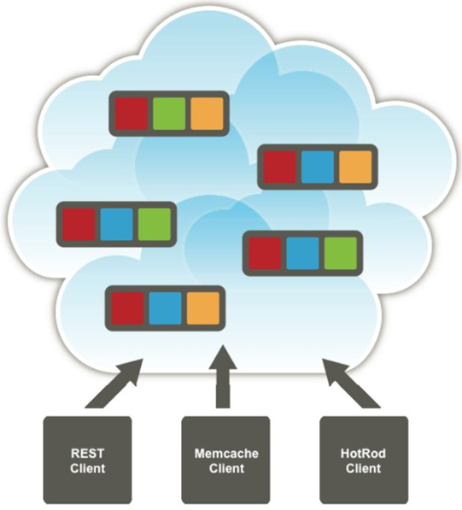
Introduction To Red Hat JBoss Data Grid
What is Red Hat JBoss Data Grid :
Based on Infinispan, the popular JBoss Community project, Red Hat JBoss Data Grid is the appropriate solution for any type of application that has heavy compute needs
JBoss Data Grid is a manageable, scalable, highly available, distributed, in-memory data store that lets you scale based on memory and distribution rather than relational database management system (RDBMS) licenses or database expertise
Data stored in the grid is usually synchronized, to balance load across all servers in the cluster as evenly as possible
Distributed data storage ENGINE composed over set of processes tat communicate with each other over a network where in each process is called a node

Slide 5

Overview Of Red Hat JBoss Data Grid
Why Red Hat JBoss Data Grid :
Tough requirements of high performance, availability, reliability, and elastic scale are met through JBoss Data Grid.
Handle unprecedented transaction volumes.
Meet high uptime requirements and deploy into hybrid cloud environments.
Provide access to accurate, real-time information
Streamline interaction with complex and rigid data tiers
Multiple access protocols – It is easy to access the data grid using REST, Memcached, Hot Rod, or simple map-like API.

Slide 6





Overview Of Red Hat JBoss Data Grid
Where to use Red Hat JBoss Data Grid :
It can be any type of application that requires heavy interaction with a data tier. Typical use cases include:
Retail and e-commerce: B2B partner-procurement data and consumer catalogs
Financial services: Options and stock-trading performance optimization
Media and entertainment: On-demand video and data management
Telecommunications
Transportation and logistics
Travel

Slide 7
Features Of Red Hat JBoss Data Grid
Features :
Schema-less key value store: Red Hat JBoss Data Grid is an in memory NoSQL database that provides a simple and flexible means to storing different objects without a fixed data model
Grid-based data storage and distributed processing: Red Hat JBoss Data Grid is a federated cluster of services to distribute, replicate, and store data, designed to seamlessly implemented , with no additional development work. Processes can be pushed to these data services to distribute workload and provide high-performance due to affinity and efficient use of compute power
Elastic scaling: Adding and removing storage nodes is achieved simply, is non-disruptive, and scale is linear. Scaling a data grid is as simple as configuring and launching a new process. All the work is completed in the background to ensure data remains distributed and replicated.
Multiple access protocols: It is easy to access the data grid using REST, memcached, Hot Rod, or through a simple java map API. The variety of access models means any sort of application – legacy or new, java or native, in-memory or remote can easily access data in the grid.
Management Tooling: JBoss Data Grid is available as a subscription from Red Hat and also includes a subscription to the JBoss Operations Network. JBoss Operations Network is a middleware and application management solution tat provides a single point of control to deploy, manage, and monitor JBoss Enterprise Middleware, applications and services

Slide 8
Advantages and Disadvantages of
Red Hat JBoss Data Grid
Advantages :
It is the best way to build high performing, resilient, and scalable web applications
Enhanced performance because data can be written to, and read from, memory much faster than is possible with a hard disk.
The data grid can be easily scaled, and upgrades can be easily implemented.
A key/value data structure, rather than a relational structure, provides flexibility for application developers
The technical advantages provide business benefits in the form of faster decision making, greater productivity, and improved customer service.
Easily handle huge transaction volumes
Meet high uptime expectations
Deploy in open hybrid cloud environments
Meet demands for accurate, real-time information Streamline interactions with the complex, rigid data tiers

Slide 9
Advantages and Disadvantages of
Red Hat JBoss Data Grid
Benefits :
Performance : Accessing objects from local memory is faster than accessing objects from remote data stores (such as a database). JBoss Data Grid provides an efficient way to store in-memory objects coming from a slower data source, resulting in faster performance than a remote data store. JBoss Data Grid also offers optimization for both clustered and non clustered caches to further improve performance.
Consistency : Storing data in a cache carried the inherent risk: at the time it is accessed, the data may be outdated (stale). To address this risk, JBoss Data Grid uses mechanisms such as cache invalidation and expiration to remove stale data entries from the cache. Additionally, JBoss Data Grid supports JTA, distributed (XA) and two-phase commit transactions along with transaction recovery and a version API to remove or replace data according to saved versions.
Massive Heap and High Availability : In JBoss Data Grid, applications no longer need to delegate the majority of their data lookup processes to a large single server database for performance benefits. JBoss Data Grid employs techniques such as replication and distribution to completely remove the bottleneck that exists in the majority of current enterprise applications.

Slide 10
Modes Of Red Hat JBoss Data Grid
Two usage modes of Red Hat JBoss Data Grid :
Library mode : This mode provides all the binaries required to build and deploy a custom runtime environment. It allows local access to a single node in a distributed cluster. This mode gives the application access to data grid functionality within a virtual machine in the container being used. Supported containers include JBoss AS 7, JBoss Enterprise Application Platform 6 and Tomcat 7
Client-server mode : This mode provides a managed, distributed and clusterable data grid server. Applications can remotely access the data grid server using Hot Rod, memcached or REST client APIs., the Cache is stored in a managed, distributed and clusterable data grid server. Applications can remotely access the data grid server using Hot Rod, memcached or REST client APIs. This web application bundles only the Hot Rod client and communicates with a remote JBoss Data Grid (JDG) server. The JDG server is configured via the standalone.xml configuration file

Slide 11
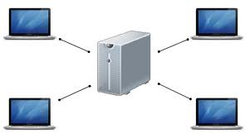
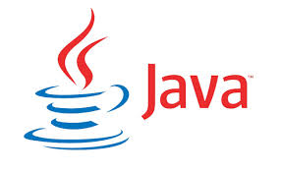
Server vs. Library
Why to run as Server :
Data tier is tuned and managed independently
Application restarts and crashes will not affect data tier
Data tier can be shared across multiple apps
Apps need not be JVM based
Anything that can talk over a socket can be used
Why to run as Library :
Library has more features, richer APIs
Programmatic as well as declarative configuration
Extendable/embeddable
Faster as it lives within the same process

Slide 12
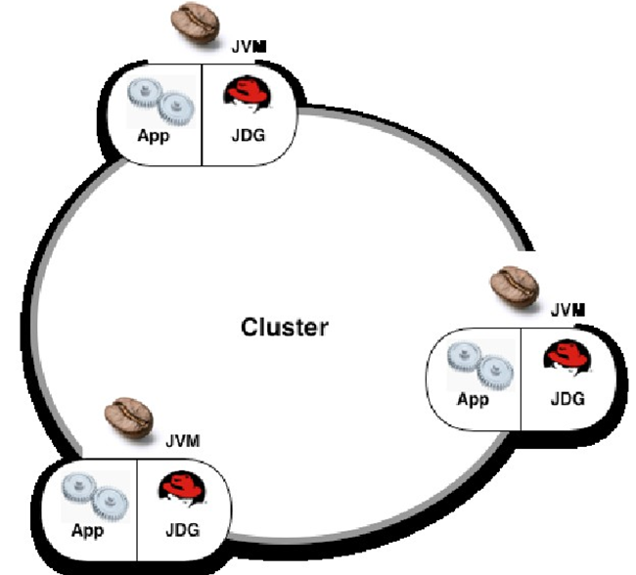
Run JBoss Data Grid in Library Mode
JDG Library :
Library mode allows the user to build and deploy a custom runtime environment
Library usage mode hosts a single data grid node in the applications process, with remote access to nodes hosted in other JVMs
Tested containers for JBoss Data Grid 6 Library mode includes Tomcat 7 and JBoss Enterprise Application Platform 6
Use Library mode if you require:
transactions.
listeners and notifications.

Slide 13
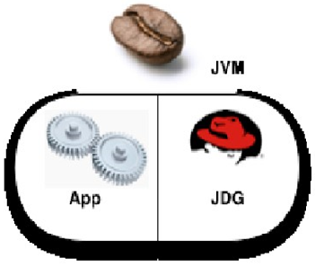
Run JBoss Data Grid in Remote Client-Server Mode
JDG Standalone :
Standalone mode refers to a single instance of JBoss Data Grid operating in local mode
In local mode, JBoss Data Grid operates as a simple single-node in-memory data cache
Run the following script to start JBoss Data Grid in standalone mode:
$JDG_HOME/bin/standalone.sh
Above command starts JBoss Data Grid using the default configuration information provided in the $JDG_HOME/standalone/configuration/standalone.xml file

Slide 14

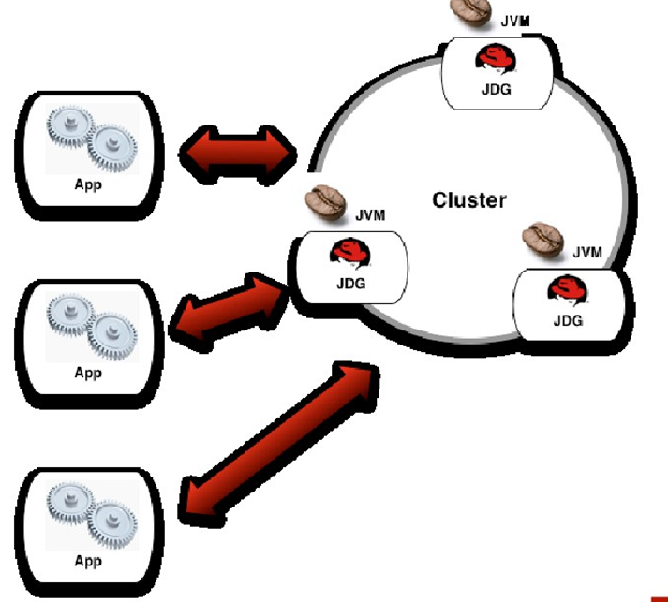
Run JBoss Data Grid in Remote Client-Server Mode
JDG Cluster Mode :
Clustered mode refers to a cluster made up of two or more JBoss Data Grid instances
Run the following script to start JBoss Data Grid in clustered mode
$JDG_HOME/bin/clustered.sh
Above command starts JBoss Data Grid using the default configuration information provided in the $JDG_HOME/standalone/configuration/clustered.xml file

Slide 15
Server End-Point Protocols
 | Protocol | Client Libraries | Clustering | Smart Routing | Load Balancing/ Failover
REST | Text | N/A | Yes | No | Any HTTP Load Balancer
MEMCACHED | Text | PHP, Java .NET, Windows, Linux | Yes | No | Only with predefined server list
HOT ROD | Binary | Java, Python, Ruby | Yes | Yes | Dynamic

Slide 16


Three main features which makes JDG impressive
Scalability :
Consistent-hash based data distribution
Based on the proven Amazon Dynamo paper and design
Linear in nature
Throughput (Transaction per second)
Capacity
Consistency :
Strongly Consistent - Congruent with most databases
JTA Transactions
Fully XA Complaint - with XA Recovery Support

Slide 17
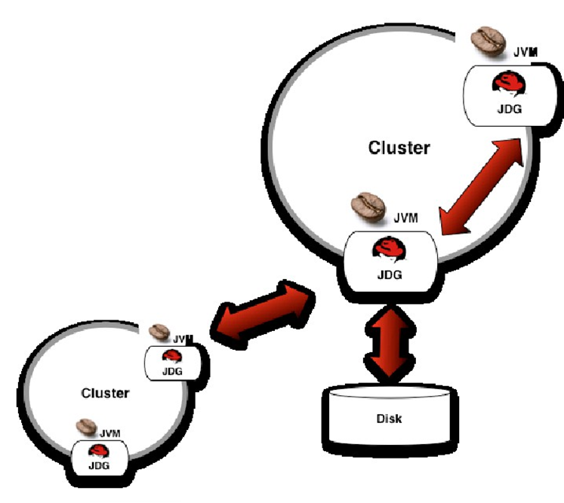
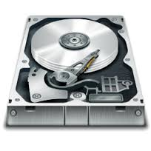
Three main features which makes JDG impressive
Durability :
Persistence to disk or database
Replication to secondary cluster
Writing to disc
Supported Storage engines:
File system
JDBC Database
custom [write your own pluggable implementations]

Slide 18
JBoss Data Grid API’s
JBoss Data Grid provides the following programmable APIs :
Cache
Batching
Grouping
Cache Store and Configuration Builder
Externalizable
Notification (also known as the Listener API because it deals with Notifications and Listeners)
API’s for Remote-Client Server mode :
The Asynchronous API (can only be used in conjunction with the Hot Rod Client in Remote Client-Server Mode)
The REST Interface
The Memcached Interface
The Hot Rod Interface
The Remote Cache API

Slide 19
Installing Red Hat JBoss Data Grid
Prerequisite :
Java Virtual Machine (compatible with Java 6.0 or higher)
Download :
Access the Customer Service Portal : Log into the Customer Service Portal here
Locate the Product : Select Data Grid under JBoss Enterprise Middleware in Downloads tab.
Download JBoss Data Grid : Select JBoss Data Grid Server {VERSION} for JBoss Data Grid with the Remote Client-Server usage mode or JBoss Data Grid Library {VERSION} for JBoss Data Grid with the Library usage mode
Install :
Run the following command to unzip the downloaded JBoss Data Grid package in RHEL Machine :
unzip {Package Name}

Slide 20
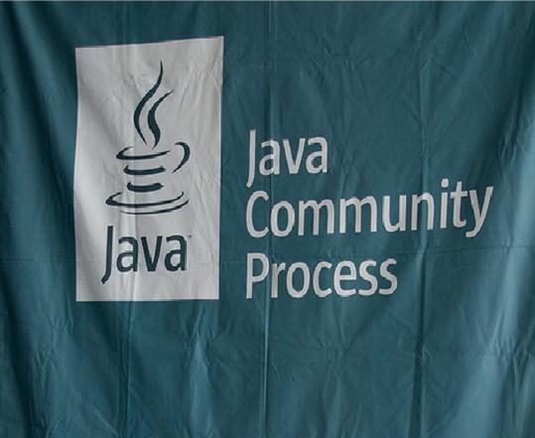
Standards
JSR 107
“Temporary Caching for the Java Platform”
JSR 347
“Data Grids for the Java Platform”

Slide 21
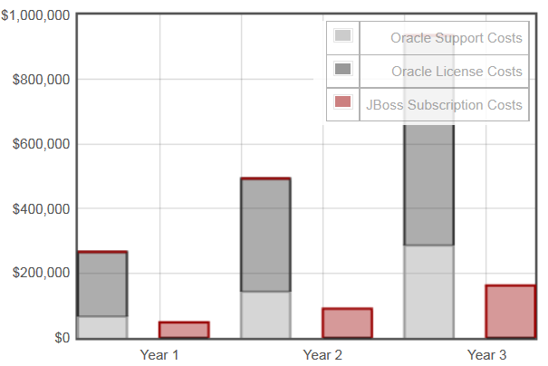
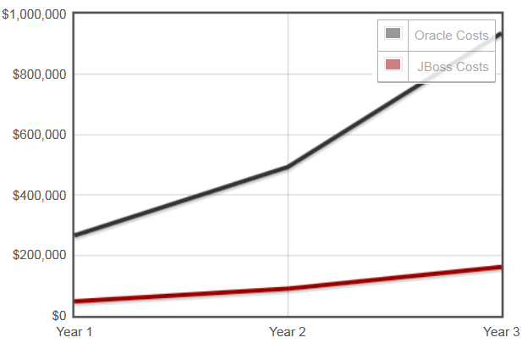
JBoss Data Grid vs. Oracle Web Logic Coherence
Reference :
Red Hat JBoss Data Grid Comparison Calculator

Slide 22
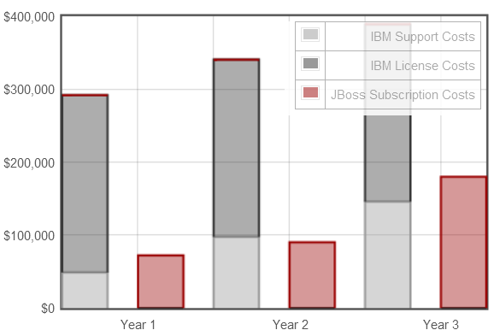
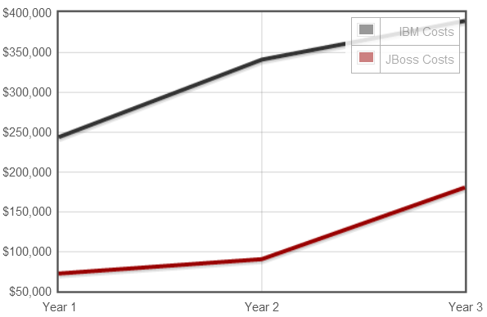
JBoss Data Grid vs. IBM Web Sphere extreme Scale
Reference :
Red Hat JBoss Data Grid Comparison Calculator

Slide 23
Thank you
Visit us at www.techmahindra.com

